Slide 1
CSC309: Artificial Intelligence
Ali Ahmad Aminu, PhD
Computer Science Department, Gombe State University
2025/2026 Session

Slide 2
Course Content/Lecture Schedule/Course Books
Course Syllabus
Overview of Artificial Intelligence (AI)
Intelligent Agents
Search
Problems and Techniques in AI
Knowledge Representation
Natural Language Processing
Expert Systems
Programming Languages for AI
Computer Image Recognition
Lecture Schedules
Wednesdays: 8AM – 10AM
Course Books
Artificial Intelligence Illuminated - Ben Coppin
Artificial Intelligence: A Modern Approach - Stuart Russell and Peter Norvig

Slide 3
Course Grading
This course will be graded as follows:
Attendance: 05%
Mini Project : 20%
Test: 15%
Final Exam: 60%

Slide 4
Mini Project : 20%
CSC 309 Mini Project
Students are required to complete a mini project as part of the CSC 309 course.
Each student must select one topic from the list below and develop a simple AI-based system related to the chosen topic.
Important:
No two students are allowed to submit the same project.
Students can work on the same topic but on a different problem.
Mini Project Topics
1. Question Answering Chatbot – Develop a chatbot that can answer user questions based on predefined knowledge or a dataset.
2. Spam Detection System – Build a model that classifies messages or emails as spam or not spam.
3. Sentiment Analysis System – Create a system that analyzes text and determines whether the sentiment is positive, negative, or neutral.
4. Machine Translation System – Develop a simple system that translates text from one language to another.
5. Speech Recognition System – Implement a system that converts spoken words into text.

Slide 5
Mini Project: 20%
Mini Project Deliverables
Each student must submit the following:
1. A working system/application
2. Sample outputs demonstrating the functionality of the system
3.
System documentation explaining:
Project objective
Method used
Tools or programming language used
Results and screenshots
Project Due Date
The submission deadline will be announced soon.

Slide 6
Week 1: Outline
Introduction
Definition of Artificial Intelligence (AI)
Types of AI
Turing Test
History of AI
Branches of AI
Applications of AI
Advantages and Disadvantages of AI
Intelligent Agent
Types of Agent
Structure of Intelligent Agent
Agent’s environment

Slide 7
Week 1: What is Intelligence ?
What is Intelligence ?
Webster’s Dictionary – “The ability to learn and solve problems”
Ben Coppin – “An ability to deal with new situations ”
The ability to solve problems
The ability to answer questions
The ability to devise plans
Etc,

Slide 8
Week 1 : What is Artificial Intelligence (AI)?
Can machines think ?
A question raised by British Computer Scientist Alan Turing at the beginning of the 1950s.
This question triggered curiosity about intelligent machines, leading to the creation of modern technologies that can listen, interpret, and respond to human commands.
AI is a branch of Computer science dealing with computers or machines that imitate human intelligence
AI definition by some experts
John McCarthy (1955): "The science and engineering of making intelligent machines, especially intelligent computer program"
Russell & Norvig (2010): “The study and design of intelligent agents, where an agent is a system that perceives it environment and takes action that maximizes its chances of success.”

Slide 9
Week 1 : Why AI?
Andrew Ng said, “Just as the industrial revolution freed up a lot of humanity from physical labor, I think AI has the potential to free up humanity from a lot of mental labor”
The development of AI is driven by the need to automate tasks that are time-consuming, repetitive, or dangerous for humans.
AI has already proven useful in several areas, such as healthcare, finance, manufacturing, and transportation.
It has the potential to revolutionize many other fields, such as education, agriculture, and entertainment

Slide 10
Week 1 : Goals of AI
The primary goals of AI are to:
To enhance human capabilities: AI can help humans perform tasks more efficiently and effectively
Solve complex problems: AI can analyze large amounts of data to solve complex problems that would be impossible for humans to solve alone.
Create intelligent machines: The ultimate goal of AI is to create machines that can perform any intellectual task that a human can i.e. creating systems that understand, think, learn, and behave like humans

Slide 11
Week 1 : Types/Stages of AI
AI can be classified into three types or stages
Weak Artificial Intelligence
The weak AI is also called Artificial Narrow Intelligence (ANI)
ANI is the most successful realized form of AI
It is goal oriented and is designed to carryout a single task extremely well
Uses techniques such as NLP, DL and ML to perform their task
Examples
All expert systems that emulate the decision making ability of humans belongs to this category.
SIRI and Alexa (speech recognition/assistant systems)

Slide 12
Week 1 : Types/Stages of AI
Strong AI
Strong AI also called Artificial General Intelligence (AGI) is a more advanced form of AI than ANI or weak AI
An AGI powered machine can mimic human intelligence and can learn and apply the same in real-time situations or problems
AGI systems goes beyond executing singular goal oriented tasks to perform proactive actions
Example
Autonomous cars uses multiple sensors systems and control functions simultaneously to successfully drive and avoid accidents

Slide 13
Week 1 : Types/Stages of AI
Artificial Super Intelligence (ASI)
ASI is far beyond mimicking or replicating human intelligence
It is the most advanced form of AI
An ASI powered machine would be self-aware and could exceed the capacity of human intelligence across a range of areas.
The conception of ASI has been a part of science fiction for a long time. However, it is debatable whether such forms of AI could be helpful or could pose a threat to humans

Slide 14
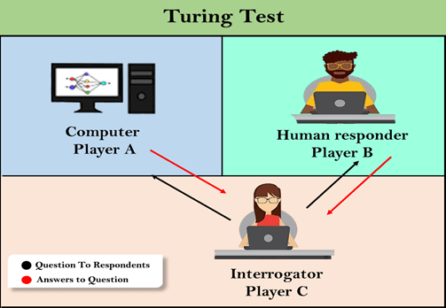
Week 1 : Turing Test
Can machines mimic Human Intelligence?
The Turing Test, designed by Alan Turing in the 1950s, tried to answer this question
In the test, there are three participants in three separate rooms: an interrogator, a human responder and a computer

Slide 15
Week 1 : Turing Test
Truing Test Process:
The interrogator quizzes both the human and the AI computer on various topics.
All responses from both participants are recorded.
After a set time or number of questions, the interrogator must identify which responses were from the computer and which were from the human.
Turing Test Criteria
The test is repeated multiple times.
If the interrogator makes incorrect identifications more than half of the time, the computer is considered to have artificial intelligence.
Significance:
The test is more philosophical than technical.
It introduced the idea that machines could potentially achieve human-like intelligence, which was a revolutionary concept in the mid-20th century.

Slide 16
Week 1 : History of AI
Origins of AI (1950s)
1950:
Alan Turing proposes the Turing Test to evaluate machine intelligence.
Claude Shannon theorizes a chess-playing machine.
Isaac Asimov formulates the Three Laws of Robotics.
1951: First AI program (checkers) runs on the Ferranti Mark 1.
1952: Arthur Samuel develops the first self-learning game program (checkers).
1956: John McCarthy coins the term "Artificial Intelligence" at the Dartmouth Conference (birth of AI as a field).

Slide 17
Week 1 : History of AI
First AI Cycle (1960s–1970s)
1965: Lotfi Zadeh introduces fuzzy logic for partial truth reasoning.
1966: Joseph Weizenbaum creates ELIZA, the first chatbot. Eliza simulated conversation with humans
1970s:
WABOT-1 (Japan), the first full scale humanoid robot, capable of working, gripping objects, and basic communications.
WABOT project was a major milestone in robotics and AI
AI Winter Begins: Funding declines due to overpromised results.

Slide 18
Week 1 : History of AI
Second AI Cycle (1980s–1990s)
1980s: Rise of expert systems (e.g., XCON for configuring computer systems).
XCON (Expert CONfigurer) was an expert system developed in the late 1970s by Digital Equipment Corporation (DEC) and Carnegie Mellon University.
It was designed to automatically configure VAX computer systems.
1987: Second AI Winter: Expert systems fail to scale; hardware market collapses.
1990s:
1997: IBM’s Deep Blue defeats chess champion Garry Kasparov.
1998: Web crawlers (e.g., Google) leverage AI for search algorithms.

Slide 19
Week 1: History of AI
Modern AI (2000s–Present)
2000s:
2002: Roomba - an autonomous robotic vacuum cleaners developed by iRobot. Roomba popularizes consumer robotics.
2006: Geoffrey Hinton pioneers deep learning with neural networks.
2010s:
2011: IBM’s Watson wins Jeopardy!.
2012: AlexNet revolutionizes image recognition (deep learning boom).
2016: AlphaGo defeats world champion Lee Sedol in the game of Go.
2020s:
2020: GPT-3 (OpenAI) advances natural language processing.
2022: DALL-E 2 enables AI-generated art.
2023: Rise of generative AI (ChatGPT, DeepSeek, Claude, Germini, etc.).

Slide 20
Week 1: History of AI
AI has evolved from theoretical concepts to transformative technologies.
“AI is the new electricity” – Andrew Ng
Cycles of hype and winter have shaped its resilient progress.
Key drivers of AI growth today include:
Computing Power: GPUs & cloud computing.
Big Data: Explosion of digital data.
Algorithms: Advances in deep learning (CNNs, RNNs, Transformers).

Slide 21
Week1: Branches of AI
Computer Vision
Expert Systems
Natural Language
Processing
Machine Learning
Branches of AI
Optimization
Neural Networks
Robotics
Fuzzy Logic

Slide 22
Week 1: Applications of AI
AI has a wide range of applications across various fields:
Healthcare
AI aids is:
Disease diagnosis (e.g., cancer detection)
Drug discovery & personalized medicine
Robotic-assisted surgeries
Finance
AI is used for:
Fraud detection and risk assessment
Algorithmic trading
AI-powered customer support (chatbots)

Slide 23
Week 1: Applications of AI
Autonomous Vehicles
Self-driving cars (Tesla, Waymo) use AI for:
navigation
obstacle detection
real-time decision-making
Manufacturing
AI-driven robots optimize:
production
predictive maintenance
and quality control
Customer Service
AI chatbots (like ChatGPT) and virtual assistants (Siri, Alexa) handle queries and automate responses.

Slide 24
Week 1: Applications of AI
Cybersecurity
AI detects anomalies, prevents cyber attacks, and enhances threat analysis.
Education
Enables adaptive learning platforms, automated grading, and AI tutors.
Agriculture
AI helps in:
crop monitoring
precision farming
pest control using drones and sensors.

Slide 25
Week 1: Pros and Cons of AI
Study this on your own

Slide 26
Intelligent Agent

Slide 27
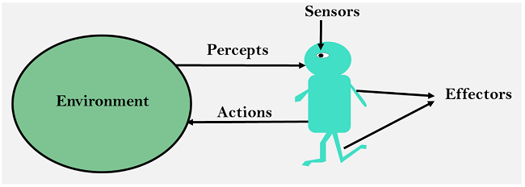
Week 1: Intelligent Agent
What is an Agent?
An agent in AI is an independent program or entity that interact with its environment by perceiving its surroundings via sensors, then acting through actuators or effectors
Any entity that perceives its environment through sensors and acts upon it through actuators or effectors
The concept of an agent is fundamental in AI, where the focus is on creating systems that can perform tasks intelligently.

Slide 28
Week 1 :Intelligent Agent
Typical example of agents in general term include:
Human-Agent: A human agent has eyes, ears, and other organs which work for sensors and hand, legs, mouth work for actuators.
Robotic Agent: A robotic agent can have cameras, infrared range finder for sensors and various motors for actuators.
Software Agent: Software agent can have keystrokes, file contents as sensory input and act on those inputs and display output on the screen. e.g. Chatbots

Slide 29
Week 1:Intelligent Agent
Some fundamental concepts
Percept
Agent’s perceptual input at any given instant
This could be data from cameras, microphones or any other sensors
E.g. For a vacuum cleaner agent, a percept could be whether the current location is dirty or clean
Percept sequence
Complete history of everything (all percepts) the agent has ever perceived
It represent everything the agent has sensed up to the current moment
The agent actions depend on this sequence
E.g. if a vacuum cleaner agent perceives [Clean, Dirty, Clean] over three time steps, that is its percept sequence.

Slide 30
Week 1:Intelligent Agent
Agent Function
The agent function is a mathematical mapping that determines the agent’s action based on its percept sequence
It maps a given percept sequence to an action
It can be represented as:
Action = f(Percept Sequence)
E.g. A simple vacuum cleaner agent function might say:
If current location is Dirty –> Suck
Else –> move to next location

Slide 31
Week 1:Intelligent Agent
Summary of fundamental Concepts
Concept | Definition | Example
Percept | Single sensory input at a given time | Camera image, "Dirty" sensor reading
Percept Sequence | Full history of all percepts | [Clean, Dirty, Clean, Dirty]
Agent Function | Rule that maps percept sequences to actions | If Dirty → Suck; Else → Move

Slide 32
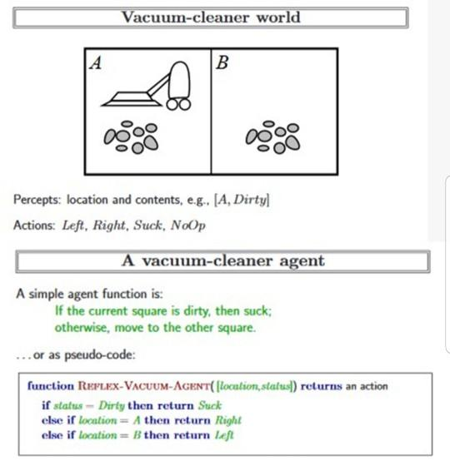
Week 1:Intelligent Agent-Vacuum Cleaner World

Slide 33
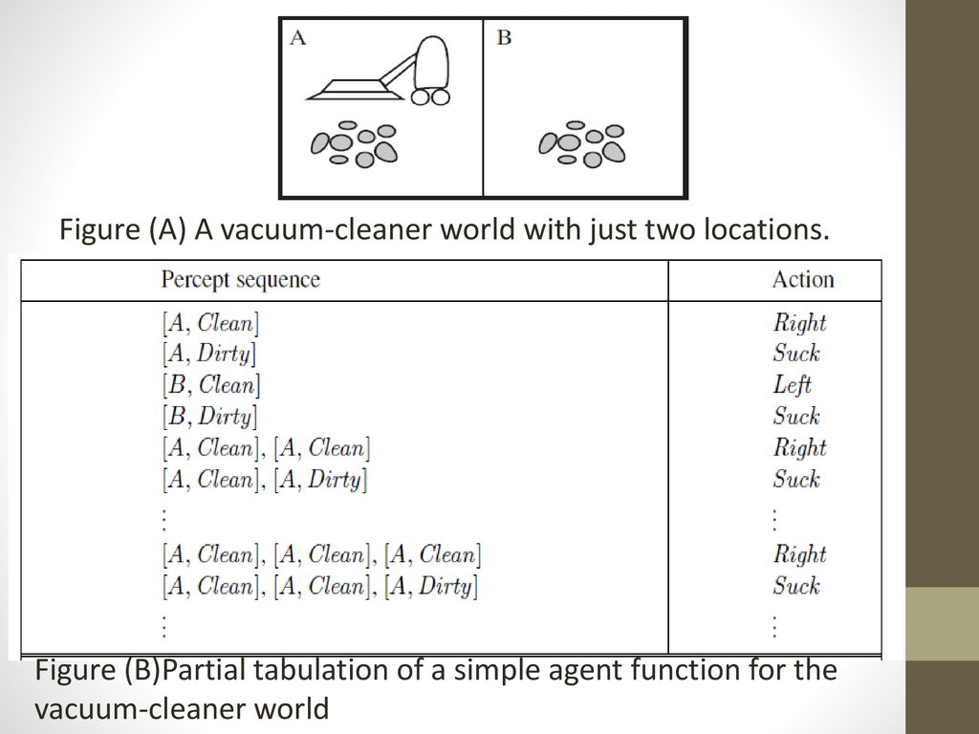
Week 1:Intelligent Agent-Vacuum Cleaner World

Slide 34
Week 1: Intelligent Agent
Intelligent Agent
An intelligent agent is an autonomous entity which act upon its environment using sensors and actuators for achieving goals.
Usually takes action that will lead to their goal
An intelligent agent may learn from the environment to achieve their goals.
Driverless cars and Siri virtual assistant are typical examples of intelligent agents in AI.

Slide 35
Week 1: Rational Agent
AI is about creating rational agents for various real world scenarios
Definition of a Rational Agent
A rational agent is an intelligent agent that takes the right decision in every situation, i.e. always act optimally.
For each possible percept sequence, an ideal rational agent does whatever possible to maximize its performance, based on:
• the percept sequence and
• its internal knowledge
The rationality of an agent depends on:
the performance measure - an objective criterion for the success of an agent’s behavior
the percept sequence - all the things perceived by the agent
the agent’s knowledge of the environment
the actions that the agent can perform

Slide 36
Week 1: Rational Agent
Example
Intelligent Agent – A vacuum cleaner robot that cleans randomly (not optimally)
Rational Agent – A vacuum cleaner robot that plans the shortest path to clean efficiently
NB:
All rational agents are intelligent agents, but not all intelligent agents are necessarily rational
Rationality depends on optimal decision making, while intelligence focuses on autonomous behavior.

Slide 37
Week 1: Task Environment
Task Environment
To design a rational agent, we must specify the “task environment”
A task environment defines the problem space within which an intelligent agent operates to achieve its goals
it includes everything the agent interacts with and everything that affects the agent’s performance
A task environment typically consist of the following components:
Performance Measure – criteria for success (e.g. speed or accuracy)
Environment – the external world the agents interacts with (e.g. , a chessboard, a physical room).
Actuators – the tools the agent uses to act upon the environment (e.g., robot arms, mouse clicks)
Sensors – the tools the agent uses to perceive its environment (e.g., cameras, keyboard)

Slide 38
Week 1: Task Environment
A task environment is easily described using the PEAS model:
Component | Description | Example (Self-Driving Car)
Performance | Measures how well the agent does its task. | Safety, travel time, fuel efficiency.
Environment | The external world the agent interacts with. | Roads, traffic, weather conditions.
Actuators | Tools the agent uses to perform actions. | Steering, brakes, accelerator.
Sensors | How the agent perceives the environment. | Cameras, LIDAR, GPS.

Slide 39
Week 1: More PEAS Examples
PEAS for Vacuum Cleaner
Performance Measure: cleanness, efficiency: distance traveled to clean, battery life, security.
Environment: room, table, wood floor, carpet, different obstacles.
Actuators: wheels, different brushes, vacuum extractor.
Sensors: camera, dirt detection sensor, cliff sensor, bump sensors, infrared wall sensors.
PEAS for Medical diagnosis system
Performance measure: Healthy patient, minimize costs, lawsuits
Environment: Patient, hospital, staff
Actuators: Screen display (questions, tests, diagnoses, treatments, referrals)
Sensors: Keyboard (entry of symptoms, findings, patient's answers)

Slide 40
Week 1: Agents Environment
Agent Environment
Everything in the world which surround the agent, but is not part of the agent itself.
A situation in which an agent is currently in
Properties/types of Environment
Fully Observable vs. Partially Observable
If an agent sensor can sense or access the complete state of an environment at each point of time then it is a fully observable environment, else it is partially observable.
A fully observable environment is easy as there is no need to maintain the internal state to keep track of history of the world.
Deterministic vs. non deterministic
If an agent's current state and selected action can completely determine the next state of the environment, then such environment is called a deterministic environment.
A stochastic environment is random in nature and cannot be determined completely by an agent.
In a deterministic, fully observable environment, agent does not need to worry about uncertainty

Slide 41
Week 1: Types of Agent Environment
Episodic vs. Sequential
An episodic environment means that subsequent episode do not depend on what actions occurred in previous episode. Such environment do not require the agent to plan ahead.
However, in Sequential environment, an agent requires memory of past actions to determine the next best actions.
Static vs. Dynamic
If the environment can change itself while an agent is deliberating/thinking then such environment is called a dynamic environment else it is called a static environment.
Static environments are easy to deal because an agent does not need to continue looking at the world while deciding for an action.
However for dynamic environment, agents need to keep looking at the world at each action.
A self-driving car come under dynamic environment whereas Crossword puzzles falls under a static environment.

Slide 42
Week 1: Types of Agent Environment
Discrete vs. Continuous
If in an environment there are a finite number of percepts and actions that can be performed within it, then such an environment is called a discrete environment else it is called continuous environment.
A chess game comes under discrete environment as there is a finite number of moves that can be performed.
A self-driving car is an example of a continuous environment.
With/Without Rational Adversaries
If an environment does not contain other rational thinking adversary agents, the agent need not to worry about strategic, game theoretic aspect of the environment.

Slide 43
Week 1:Types of Agent
Simple Reflex Agent
Model Based Reflex Agent
Goal Based Agent
Utility based Agent
Learning Agents

Slide 44
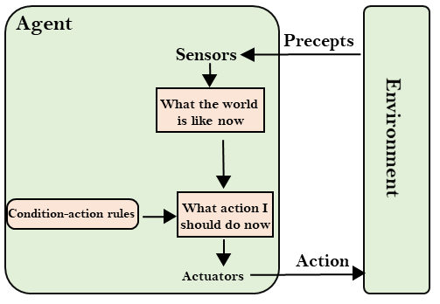
Week1: Types of Agent
Simple Reflex Agent (SRA)
Simplest Type of Agents
They take decisions on the basis of the current percepts and ignore the rest of the percepts history
They do not have memory of the past state of the world
They work on condition-action rule, which means they map their current state to action.
e.g. A vacuum cleaner that cleans only when dirt is detected

Slide 45
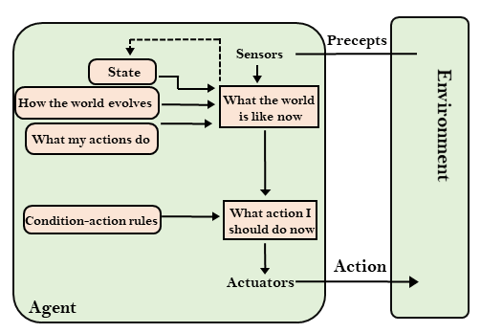
Week 1: Types of Agent
Model Based Reflex Agent (MBRA)
A more advanced form of SRA
They have:
Internal state, which tracks changes in the environment
Model, which is knowledge of the world and performs their actions based on this model
Updating the agent state requires information about:
How the world evolves
How the agent's action affects the world

Slide 46
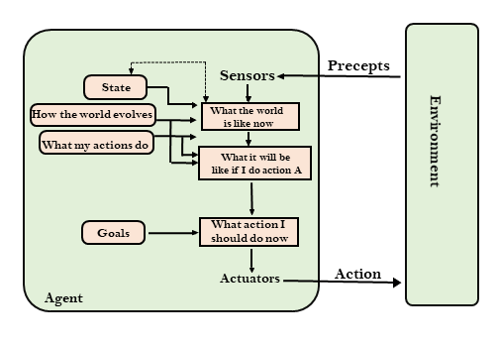
Week1: Types of Agent
Goal Based Agent (GBA)
Goal-based agents expand the capabilities of the model-based agent by having the "goal“ information - which describes desirable situations and outcomes.
They choose an action, so that they can achieve the goal.
Agent of this kind takes feature events into consideration These agents may have to consider a long sequence of possible actions before deciding whether the goal is achieved or not.
Such considerations of different scenario are called searching and planning, which makes an agent proactive.

Slide 47
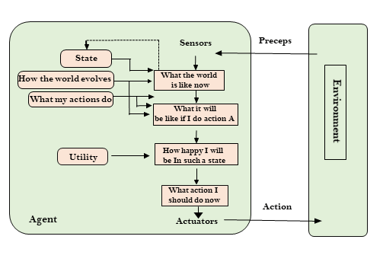
Week1: Types of Agent
Utility Based Agent (UBA)
These agents are similar to the goal-based agent but provide an extra component of utility measurement which makes them different by providing a measure of success at a given state.
Utility-based agent act based not only goals but also the best way to achieve the goal.
They select actions that maximizes desirable outcome or situations
The Utility-based agent is useful when there are multiple possible alternatives, and an agent has to choose in order to perform the best action.

Slide 48
Week1: Types of Agent
Learning Agents (LA)
Improve their performance based on previous experiences.
Continuously learn from feedback and adapt.
Example: A chatbot that becomes more accurate with user interactions

Slide 49
Week 1: Review Question
Review Questions
What is Artificial Intelligence (AI), and how did Alan Turing contribute to its development?
Compare and contrast Weak AI, Strong AI, and Artificial Super Intelligence (ASI) with examples.
Explain the difference between goal-based and utility-based agents with real-world applications.
What is the Turing Test, and what is its significance in evaluating machine intelligence?
How does the Turing Test distinguish between human and AI responses?
Outline the major milestones in the history of AI from the 1950s to the present.
What are the key factors that have driven the growth of AI in the 21st century?
Identify and explain three real-world applications of AI in healthcare and finance.
How does AI improve the efficiency of autonomous vehicles?
What distinguishes a rational agent from a simple reflex agent?
Describe the PEAS model and give an example of its application in a smart home environment.
Explain the difference between deterministic and stochastic environments. Provide an example of each.
What are the characteristics of a dynamic environment, and why is it more challenging to model?

